Slide 1



Slide 2
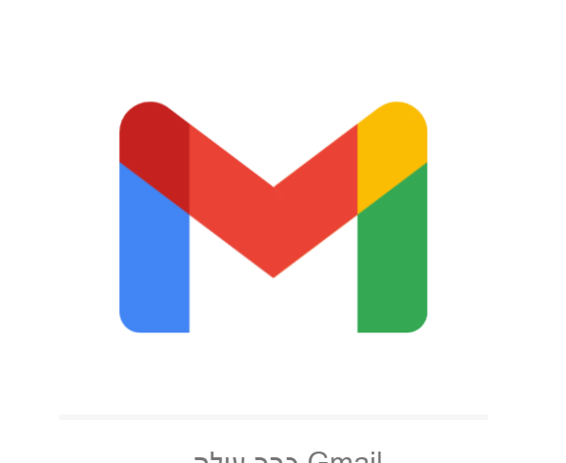
Hi friends today we will learn about
email☺

Slide 3
Ok, first thing what's an email ??
Email is software that is sed to correspond
Submit pages, forms, photos, and more

Slide 4
Plus the email has become very useful.
Because of its convenience and speed
And is used mainly by offices, company managers and the like…
Yes at work and in business…

Slide 5
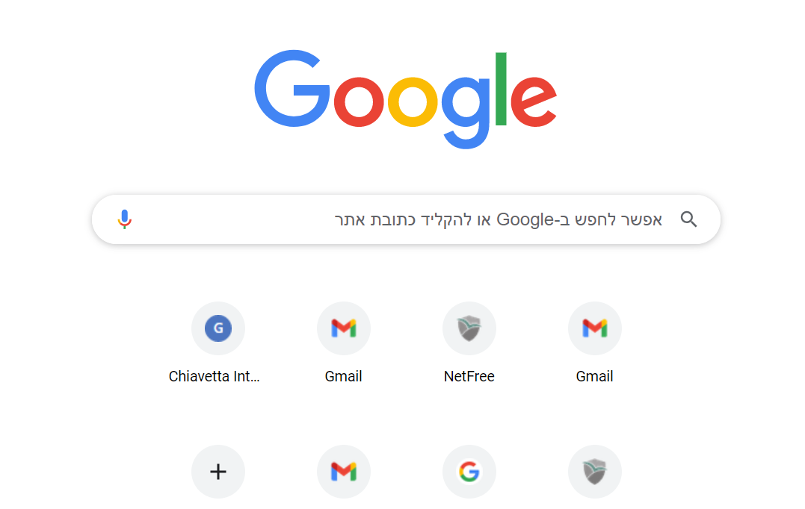

To enter the email,
click on
This sign

Slide 6
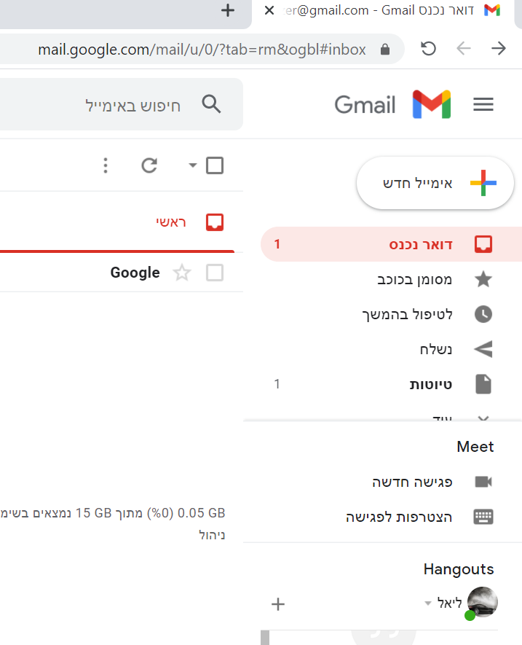
This is what the email looks like
And in this way everything can be done !!

Slide 7
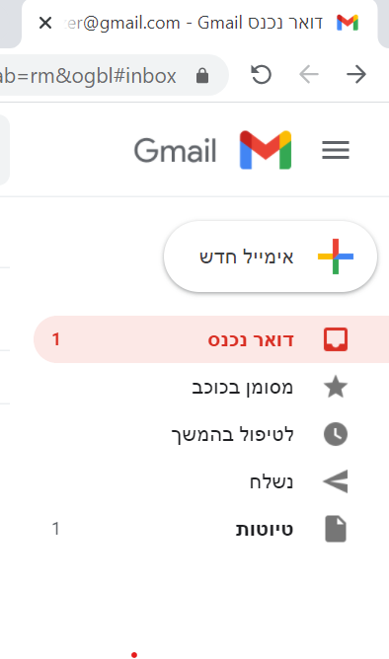
Nice to meet you,
This is our main menu,
And with its help you can navigate every time
As needed.

Slide 8


Okay, so this is the path we are entering
To all our mail what they sent us, or what we are
We sent, favorites and more ...
i In this path we enter all the favorites,

Slide 9
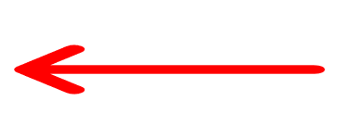

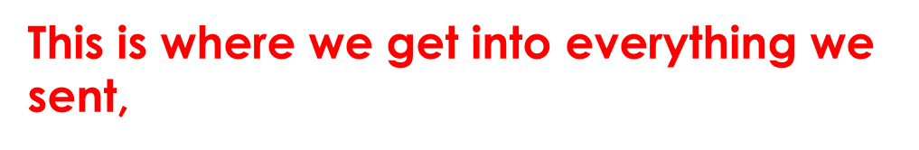

Everything we have received or sent, and we
Want to take care of them later ...

Slide 10
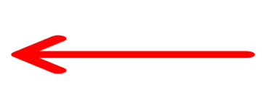

This is what we get into all our drafts,
Everything we have received or sent, and we
Want to take care of them later ...
That is, things and matters that are not urgent
so much,

Slide 11
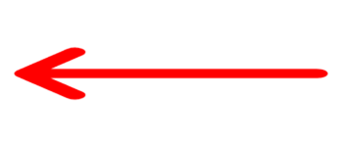
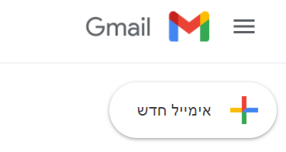
This sign is a button
With which we can
Send everything

Slide 12

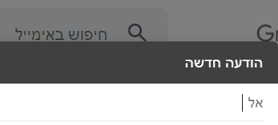
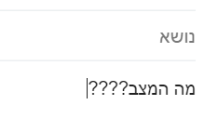
So what should be done ??
First enter the address
Here ,
And here it should
Type the text :)

Slide 13
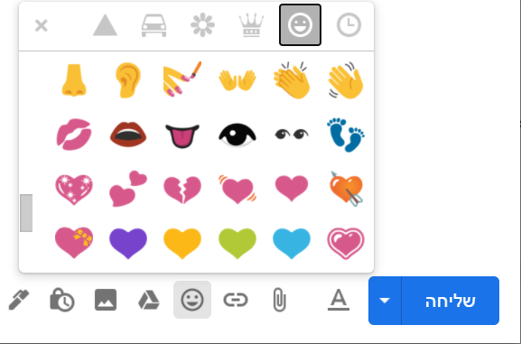

And in addition there is
Option to add
Smiley ☺ ☺ ☺
and more …

Slide 14

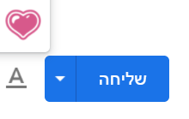
And here,
Click to send
The message.

Slide 15
And this is friends,
We finished the presentation
I hope you enjoyed,
And you learned to use
By email ....
So goodbye :)

